Slide 1



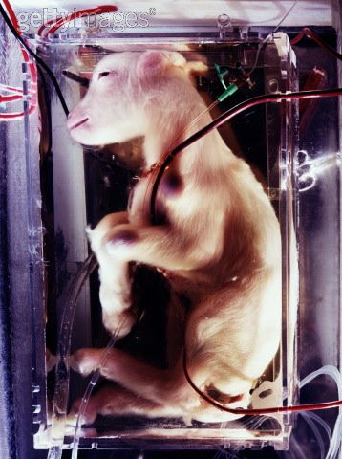
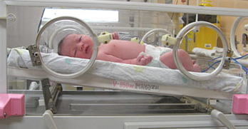

Ethics of artificial wombs: missing angles and special concerns
Sophya Yumakulov, BHSc, Gregor Wolbring, PhD
Faculty of Medicine, University of Calgary, Calgary, AB, CANADA
syumakul@ucalgary.ca, gwolbrin@ucalgary.ca
We acknowledge the support of the Wolb-Pack
Artificial womb technology
Discourses Around Artificial Wombs
The Global Perspective
Artificial womb technology (AWT): man-made technology that can gestate a fetus.
Progress to date:
1986-1997 – artificial perfusion of uteri in Italy[1]
1996 – Kubawara et al gestate goat fetus in artificial placenta for 3 weeks[2]
2002 – Hung Ching Liu et al design human uterus and grow embryos for 6 days[2]
Can be developed indirectly by the eventual meeting of IVF technology (allowing embryos to survive in vitro longer and longer) and neonatal technology (allowing premature fetuses to survive at younger and younger stages)[1]
The Abortion Debate
AWT can end the abortion debate – allowing women to terminate pregnancy without needing to kill the fetus[3]
AWT will NOT end the abortion debate, because women who seek abortion are trying to end not only pregnancy but motherhood [3]
Advantages
Keeping preterm babies alive[99]
Safer environment for the fetus[100]
Potential for fetal surgery in utero[100]
Saving IVF embryos[4]
Replace surrogacy, for women unable to have offspring[5]
Liberate women from negative effects of pregnancy and birth = gender equality[6-8]
Disadvantages
AWT would undermine women’s right to decide when/how to become mothers[3]
Risks of removing a fetus from womb[3]
Men taking over uniquely female function/experience[3]
Men gaining complete control over reproduction and women’s bodies[9]
Reduced women’s status to laborers, sex providers and breeders[10]
The Global Perspective is lacking in this literature, even though artificial womb technology has implications on a global scale.
Global Health – AWT has the potential to increase inequities between Southern and Northern countries, creating differences between countries that can afford it and countries that cannot, in terms of maternal/child health and reproductive health
Medical tourism and outsourcing – controversial technologies such as IVF and stem cell research are taken up by countries that have more lenient regulations (eg. Lebanon, India) and use them as a national source of income. AWT can easily be included in this enterprise.
Regulating reproduction – for highly populated countries where reproduction is already being controlled, and where women might be in short supply (eg. China). AWT also opens doors to genetic manipulations and “designer babies”.
The Fate of Women – exacerbating women’s rights issues already present in many countries, AWT will shift the cultural perceptions of women and their roles in society, especially where a woman’s value is measured by her ability reproduce, “bear sons”, etc.
http://myk15.blogspot.ca/2004/12/japanese-pioneers-raise-kid-in-rubber.html
What is missing?
Currently perspectives are mainly limited to American feminism
Consideration of future possibilities
Further medicalization of reproduction
Reproductive technologies are seen as women’s “rights” in industrialized countries, but this may not be true of other places (eg. used for genocide or infanticide)
Government-sponsored reproduction
Combined with Synthetic Biology = custom humans
In places where reproduction is controlled by certain groups (ie. males), AWT would be accepted, threatening women’s right.
Such “far-fetched” possibilities are not considered or discussed in current artificial womb literature, even though these visions of the future are not far-fetched at all; they have precedents in today’s world, and they can be reached by simple logical steps from where we are today.
http://farm4.static.flickr.com/3545/3441035507_23291db642_o.jpg
Study Purpose:
To understand the scope of research, discussion, and discourse around artificial womb technology, including special challenges for bioethics, women’s issues, and global health.
Research Timeline
Geography of Research
US 63%
UK 5%
Methods
Israel 4%
1970
1980
1990
2000
2010
Review of literature related to AWT
Databases
ScienceDirect, Compendex, IEEE, Communication Abstracts, Scopus, OVID(All), EBSCO(All), Academic One File, Web of Science, and JSTOR
Search Term
“artificial womb”
Inclusion/Exclusion Criteria
Include: English-language, primary research, conceptual pieces, reviews, academic newsletters, book chapters, book reviews
Exclude: Non-English, pure technical, no PDF-link
194 articles found, 133 included.
Analysis
Use Atlas.ti ver. 7 to perform content analysis, find themes, and organize data.
2
References
Australia 14%
4
Types of Articles
6
1. Simonstein, F.,Mashiacheizenberg,M. (2009). The artificial womb: A pilot study considering people's views on the artificial womb and ectogenesis in israel. Cambridge Quarterly of Healthcare Ethic, 18, 87-94.
2. Bulletti, C Palagiano, A Pace, C Cerni, A Borini, A de Ziegler,D. (2011). The artificial womb. REPRODUCTIVE SCIENCE, 1221, 124-128.
3. Langford, S. (2008). An end to abortion? A feminist critique of the 'ectogenetic solution' to abortion. WOMENS STUDIES INTERNATIONAL FORUM, 31, 263-269.
4. Reiber, D. T. (2010). The morality of artificial womb technology. National Catholic Bioethics Quarterly, 10(3), 515-528.
5. Shanley, M. L. (1993). Surrogate mothering and women's freedom: A critique of contracts for human reproduction. Signs, 18(3), 618-639.
6. Sander-Staudt, M. (2006). Chapter eight: OF MACHINE BORN? A FEMINIST ASSESSMENT OF ECTOGENESIS AND ARTIFICIAL WOMBS. Ectogenesis
7. Woolfrey, J. (2006). Chapter nine: ECTOGENESIS: LIBERATION, TECHNOLOGICAL TYRANNY, OR JUST MORE OF THE SAME? Ectogenesis
8. Weinberg, J. K. (1988). Abortion, technology and the law. The Women's Review of Books, 6(3), 9-10
9. Cannold, L. (2006). Chapter four: WOMEN, ECTOGENESIS, AND ETHICAL THEORY. Ectogenesis
10. Rowland, R. (1985). A child at any price?. an overview of issues in the use of the new reproductive technologies, and the threat to women. Women's Studies Int. Forum, 8(6), 539-546.
8
10
12
Number of articles

